Slide 1
Algorithms: K Nearest Neighbors
1

Slide 2
KNN (K — Nearest Neighbors) is one of many (supervised learning) algorithms used in data mining and machine learning, it’s a classifier algorithm where the learning is based “how similar” is a data (a vector) from other .

Slide 3


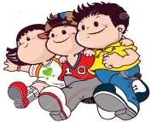
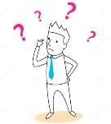

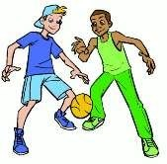
Simple Analogy..
Tell me about your friends(who your neighbors are) and I will tell you who you are.
3

Slide 4
What is KNN?
A powerful classification algorithm used in ML
K nearest neighbors stores all available cases and classifies new cases based on a similarity measure(e.g distance function)
One of the top data mining algorithms used today.
A non-parametric lazy learning algorithm (An Instance- based Learning method).
4

Slide 5
Nearest Neighbor Algorithm
Learning Algorithm:
Store training examples
Prediction Algorithm:
To classify a new example x by finding the training example (x^{i},y^{i}) that is nearest to x
Guess the class y = y^{i}

Slide 6
It is used for classification and regression. In both cases, the input consists of the k closest training examples in data set.
K in KNN represents the number of the nearest neighbors we used to classify new data points.
The output depends on whether k-NN is used for classification or regression:

Slide 7
In k-NN classification, the output is a class membership. An object is classified by a plurality vote of its neighbors, with the object being assigned to the class most common among its k nearest neighbors (k is a positive integer, typically small).
If k = 1, then the object is simply assigned to the class of that single nearest neighbor.
In k-NN regression, the output is the property value for the object. This value is the average of the values of k nearest neighbors.

Slide 8
KNN classifies the new data points based on the similarity measure of the earlier stored data points.
For example, if we have a dataset of tomatoes and bananas. KNN will store similar measures like shape and color.
When a new object comes it will check its similarity with the color (red or yellow) and shape.

Slide 9
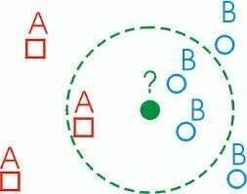
KNN: Classification Approach
An object (a new instance) is classified by a majority votes for its neighbor classes.
The object is assigned to the most common class amongst its K nearest neighbors.(measured by a distant function )
10

Slide 10
The KNN’s steps are:
— Receive an unclassified data;
— Measure the distance (Euclidian, Manhattan, Minkowski or Weighted) from the new data to all others data that is already classified;
— Gets the K(K is a parameter that you difine) smaller distances;
— Check the list of classes had the shortest distance and count the amount of each class that appears;
— Takes as correct class the class that appeared the most times; 6 —Classifies the new data with the class that you took in step 5;

Slide 11
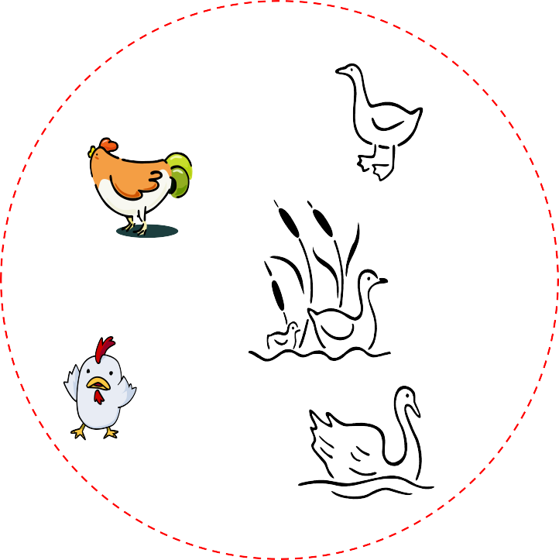
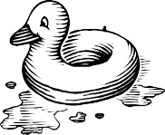
Distance Measure
Compute Distance
Test Record
Training Records
Choose k of the “nearest” records

Slide 12
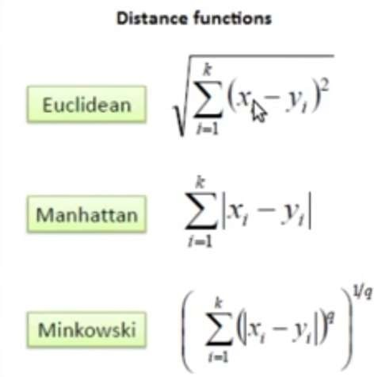
Distance measure for Continuous
Variables

Slide 13
Distance Between Neighbors
Calculate the distance between new example
(E) and all examples in the training set.
Euclidean distance between two examples.
– X = [x1,x2,x3,..,xn]
– Y = [y1,y2,y3,...,yn]
– The Euclidean distance between X and Y is defined
as:
n
D( X,Y ) = ∑(x_{i} − y_{i} ) ²
i=1
11

Slide 14
K-Nearest Neighbor Algorithm
All the instances correspond to points in an n-dimensional feature space.
Each instance is represented with a set of numerical attributes.
Each of the training data consists of a set of vectors and a class label associated with each vector.

Slide 15
Classification is done by comparing feature vectors of different K nearest points.
Select the K-nearest examples to E in the training set.
Assign E to the most common class among its K-nearest neighbors.

Slide 16
How to choose K?
If K is too small it is sensitive to noise points.
Larger K works well. But too large K may include majority points from other classes.
X
Rule of thumb is K < sqrt(n), n is number of examples.

Slide 17
How to choose K?
In real-life problems where we have many points the question arises is how to select the value of K?
Choosing the right value of K is called parameter tuning and it’s necessary for better results.
Odd value of K is always selected to avoid confusion between 2 classes.

Slide 18
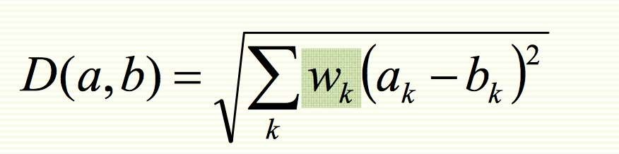
KNN Feature Weighting
Scale each feature by its importance for classification
Can use our prior knowledge about which features are more important
Can learn the weights w_{k} using cross-validation (to be covered later)

Slide 19









3-KNN: Example(1)
 |  |  |  | YES
sqrt [(35-37)²+(35-50)² +(3- 2)²]=15.16
sqrt [(22-37)²+(50-50)² +(2- 2)²]=15
sqrt [(63-37)²+(200-50)² +(1- 2)²]=152.23
sqrt [(59-37)²+(170-50)² +(1- 2)²]=122
sqrt [(25-37)²+(40-50)² +(4- 2)²]=15.74
?

Slide 20
Since this algorithm relies on distance for classification, if the features represent different physical units or come in vastly different scales then normalizing the training data can improve its accuracy dramatically.

Slide 21

Feature Normalization
Distance between neighbors could be dominated by some attributes with relatively large numbers.
 e.g., income of customers in our previous example.
Arises when two features are in different scales.
Important to normalize those features.
– Mapping values to numbers between 0 – 1.

Slide 22


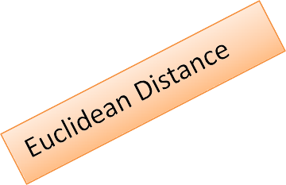
KNN Classification – Distance
Age | Loan | Default | Distance
25 | $40,000 | N | 102000
35 | $60,000 | N | 82000
45 | $80,000 | N | 62000
20 | $20,000 | N | 122000
35 | $120,000 | N | 22000
52 | $18,000 | N | 124000
23 | $95,000 | Y | 47000
40 | $62,000 | Y | 80000
60 | $100,000 | Y | 42000
48 | $220,000 | Y | 78000
33 | $150,000 | Y | 8000
48 | $142,000 | ?
D = (x − x )² +(y − y )²
1 2 1 2

Slide 23


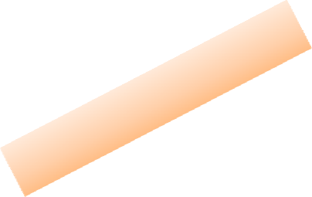
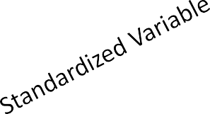
KNN Classification – Standardized Distance
Age |  | Loan |  | Default | Default |  | Distance
0.125 |  | 0.11 |  | N | N |  |  | 0.7652
0.375 |  | 0.21 |  | N | N |  |  | 0.5200
0.625 |  | 0.31 |  | N | N |  |  | 0.3160
0 |  | 0.01 |  | N | N |  | 0.9245
0.375 |  | 0.50 |  | N | N |  | 0.3428
0.8 |  | 0.00 |  | N | N |  | 0.6220
0.075 |  | 0.38 |  | Y | Y |  | 0.6669
0.5 |  | 0.22 |  | Y | Y |  | 0.4437
1 |  | 0.41 |  | Y | Y |  | 0.3650
0.7 |  | 1.00 |  | Y | Y |  | 0.3861
0.325 |  | 0.65 |  | Y | Y |  | 0.3771
0.7 |  | 0.61 |  |  | ?
_{X =} X − Min
Max − Min

Slide 24
Strengths of KNN
Very simple and intuitive.
Can be applied to the data from any distribution.
Good classification if the number of samples is large enough.
Weaknesses of KNN
Takes more time to classify a new example.
need to calculate and compare distance from new example to all other examples.
Choosing k may be tricky.
Need large number of samples for accuracy.

